Slide 1
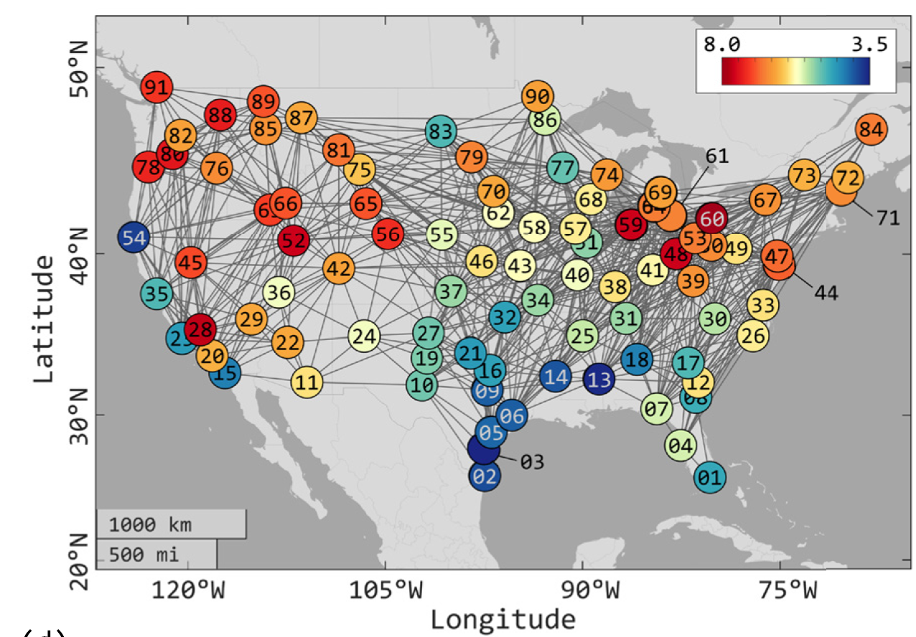

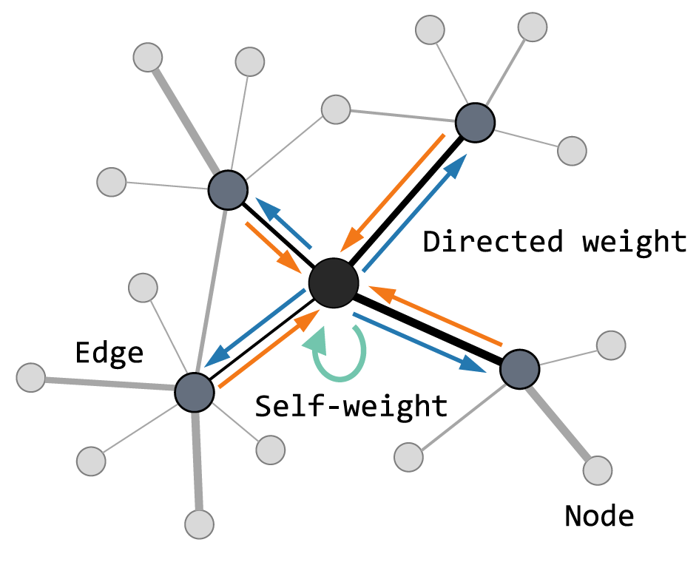
How to make accurate predictions on unstructured meshes?
?
Source: Li et al. (2023)

Slide 2


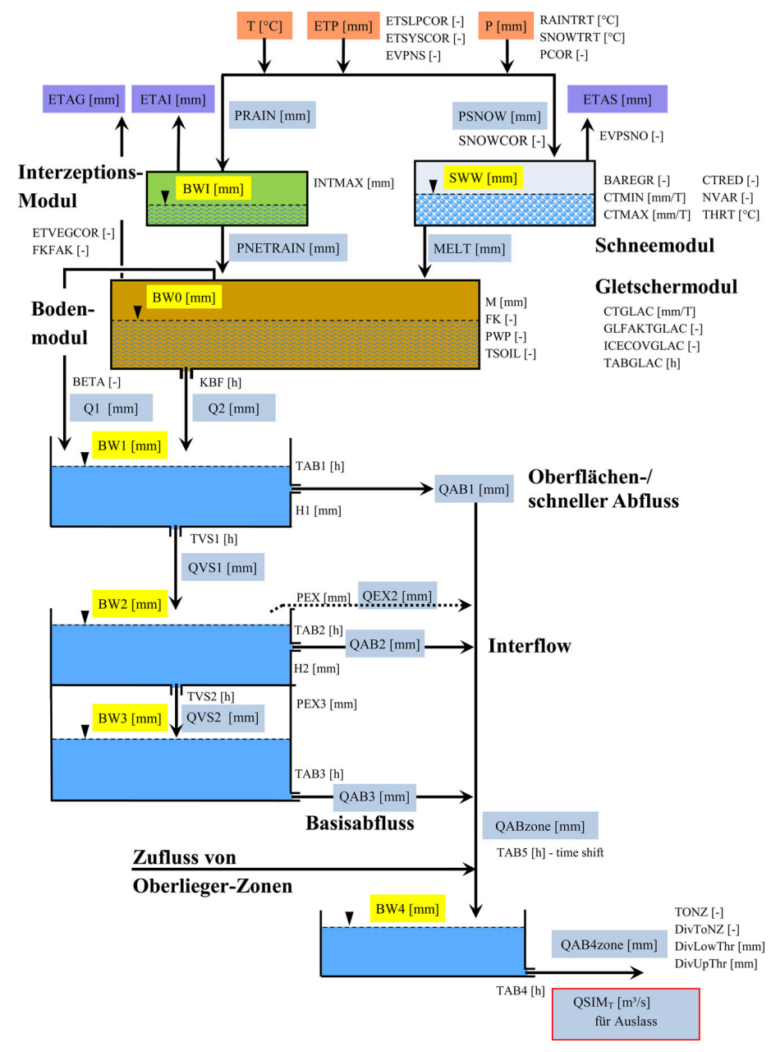
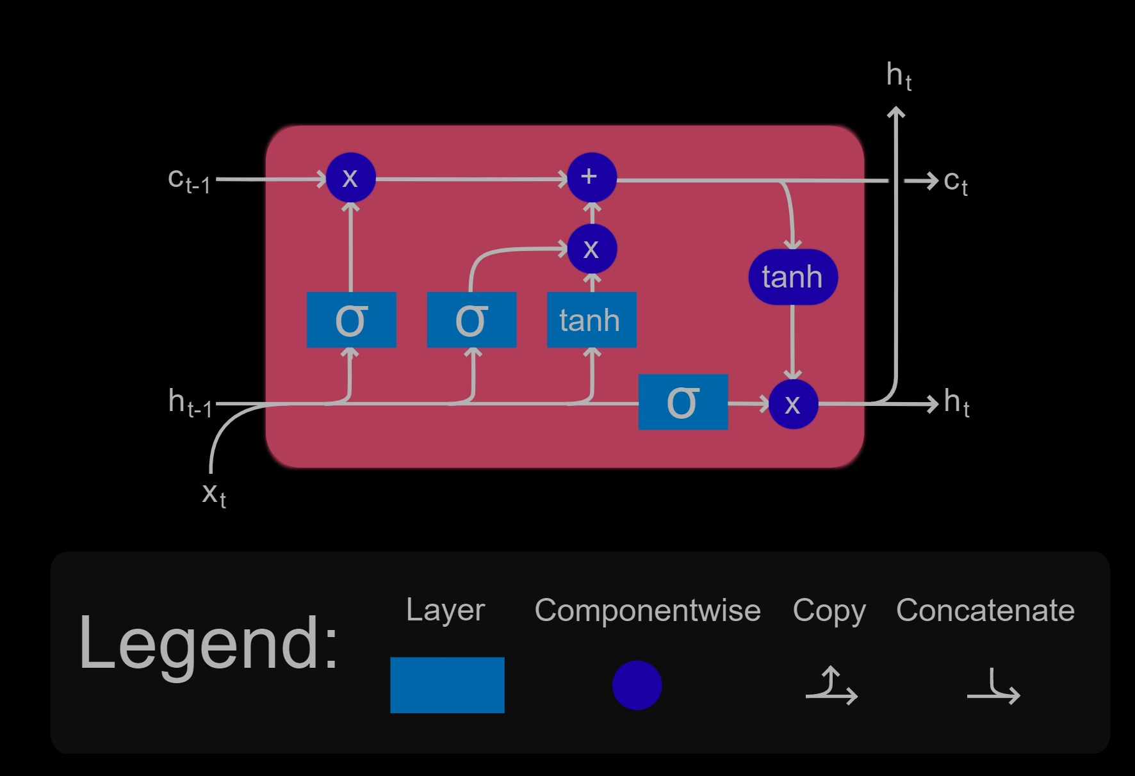
ML for Earth & Env Sci (Week 8, FA2024)
How can we make accurate predictions from sequences?
?
Source: Wesemann et al. (2018), Wikipedia (LSTM)
Notes:
COSERO hydrological model

Slide 3
Thank you for your feedback on the course!
In next week’s quiz, we will add a non-graded question:
How many hours per week do you spend on this class outside of the classroom?

Slide 4
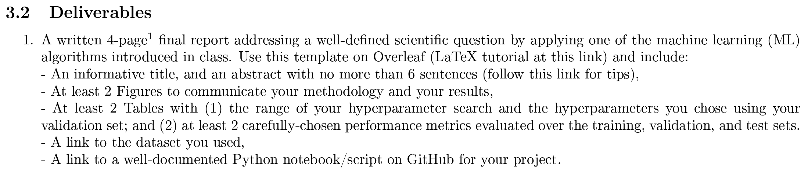
In-class Peer Review: Friday, Dec 6th, 2PM-4PM
Submit first draft of your project by Thursday, Dec 5th

Slide 5
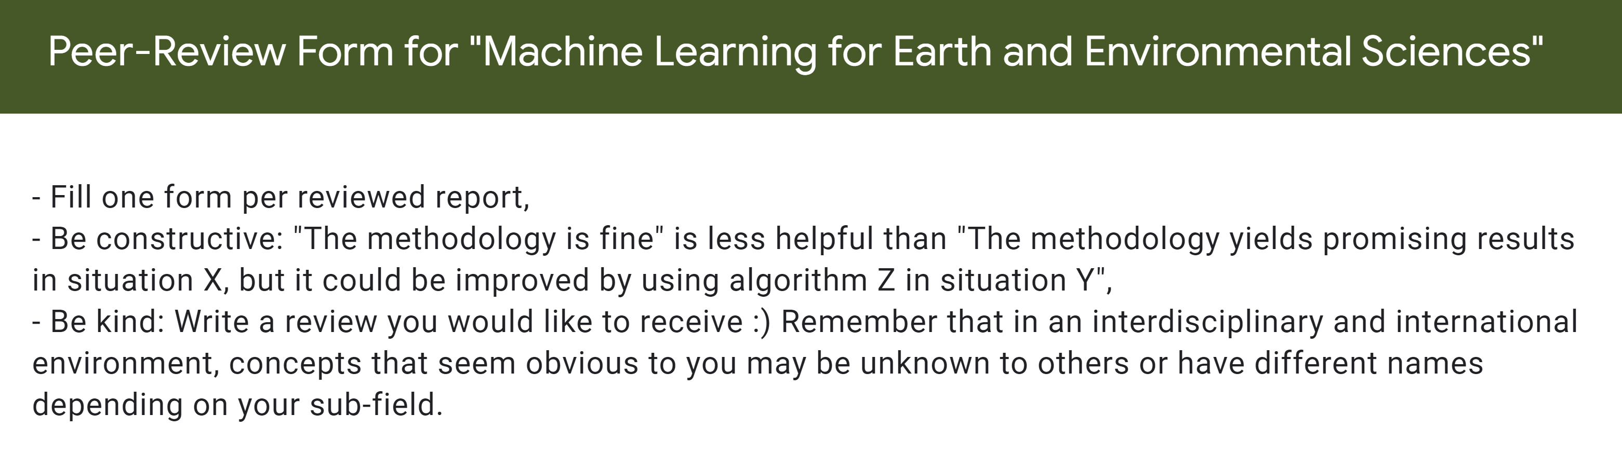

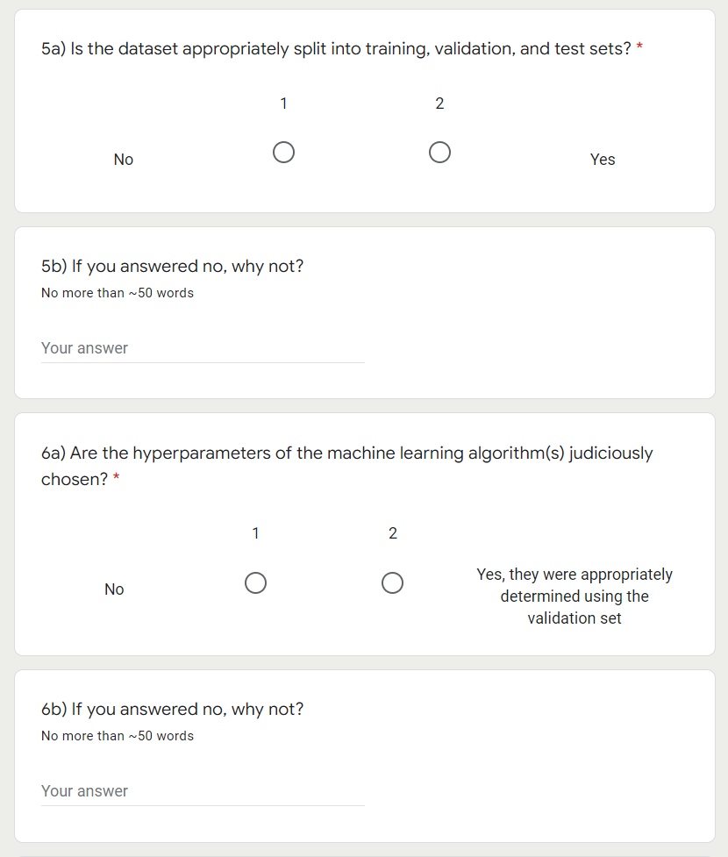

Slide 6
Final Presentations in room 2138 Friday, Dec 13th from 2PM to 4PM
4min presentations + 1min Q&A
Tip = 1 slide/minute
Scientific question: What’s our goal and why do we care?
Dataset: Characteristics, challenges, training/validation/test split, etc.
Methodology: Which ML algorithm(s) did you choose and why?
Results: What are your findings and how does it answer the sci. question?

Slide 7
Min 15-35: Recurrent Neural Networks & Convolutional NNs to Process Sequences
Learning Objectives (Géron Ch15 & Ch16):
Define a recurrent neural network
Distinguish recurrent from convolutional neural networks
Discuss the forecasting of environmental time series
Know at least three algorithms to process time-series

Slide 8

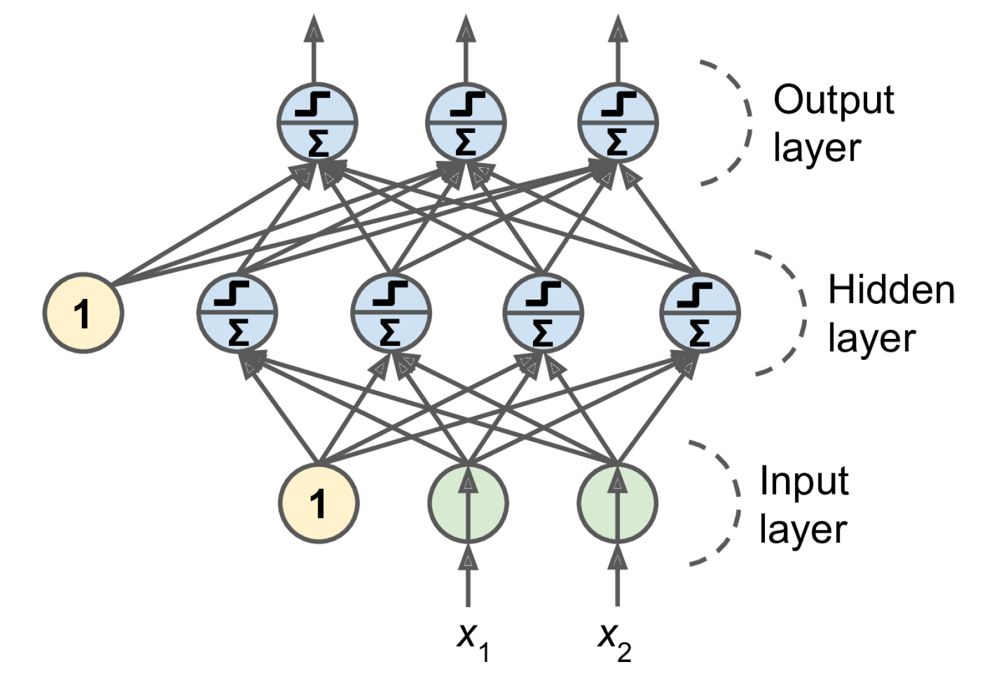
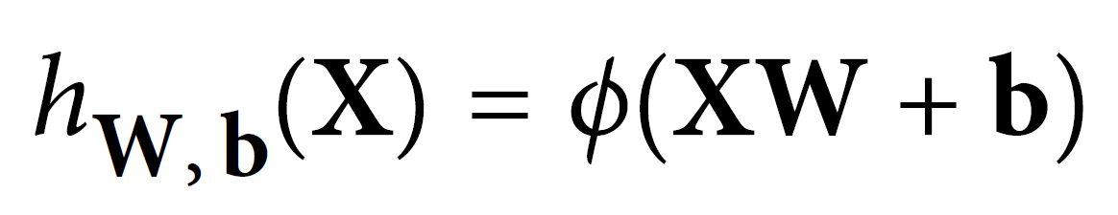
Two weeks ago = general case: Artificial Neural Networks
Notes:
1 layer = similar to logistic regression
2 layers = shallow neural network
Deep learning = 3 layers and above
VOTE: How many weights in the first layer if we have to process two sequences of 10 steps? 20 steps?

Slide 9


Last week = Convolutional Neural Networks (CNNs)
Regularized versions of Artificial Neural Networks used to process images
Source: Giphy, Analytics India Magazine (K. Maladkar)

Slide 10
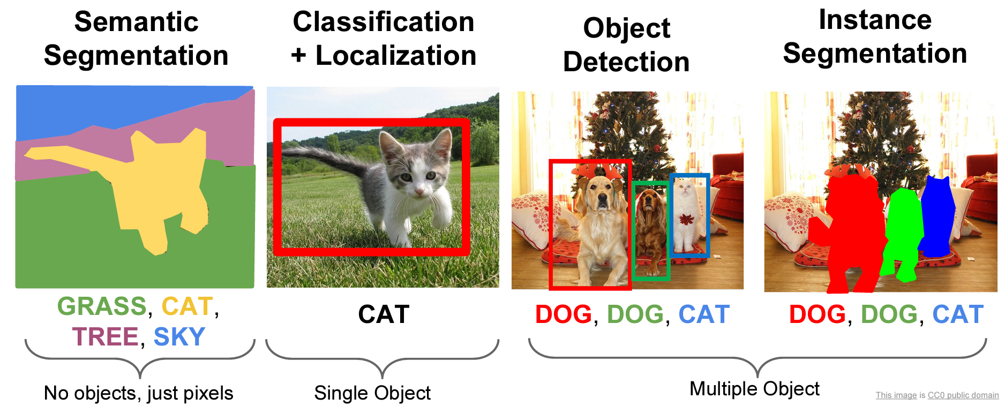
CNNs used for computer vision (analyzing images, videos)
Source: Stanford (CS231)

Slide 11
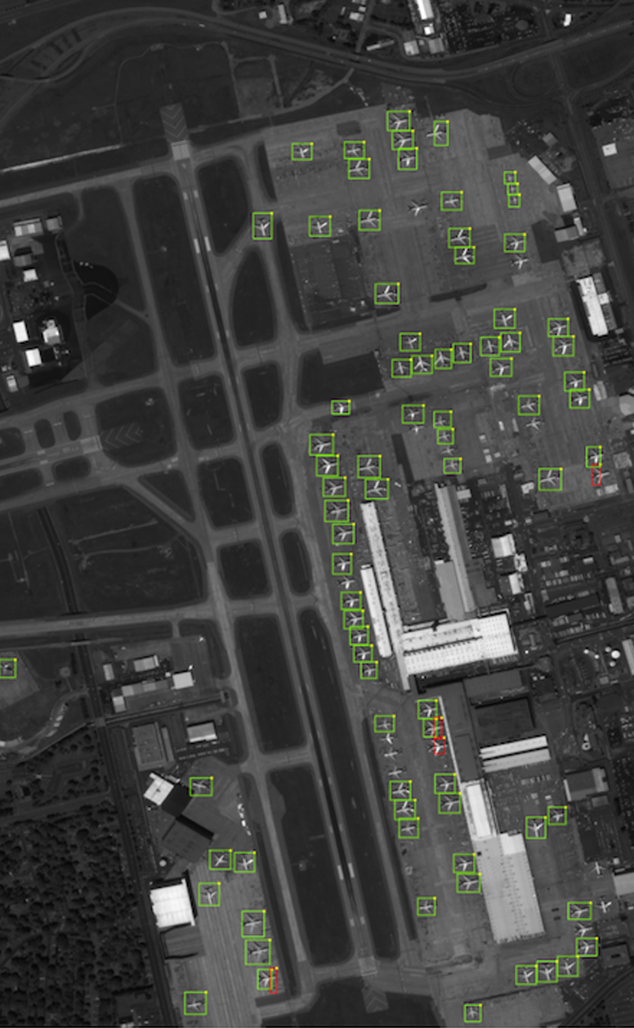
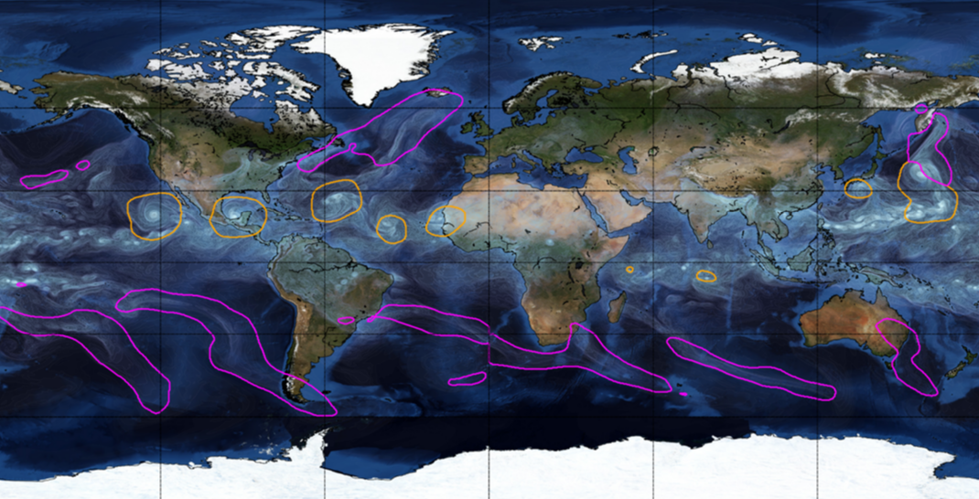
Object Detection for Remote Sensing
Instance Segmentation for Storm Detection
Source: Zhu et al. (2017), Prabhat et al. (2020)

Slide 12

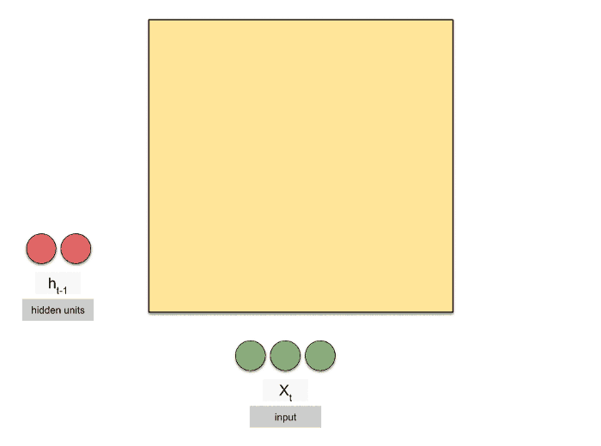
This week: Recurrent Neural Networks (RNNs)
Regularized versions of ANNs to process temporal sequences
Source: Michael Phi, Raimi Karim (Towards Data Science)

Slide 13
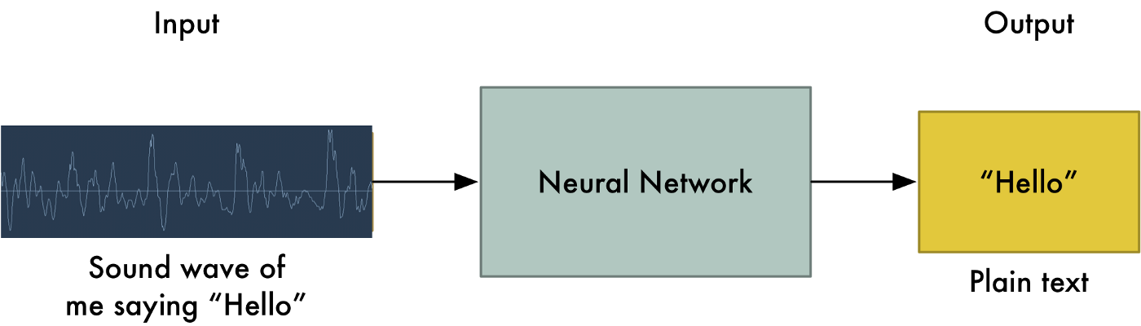
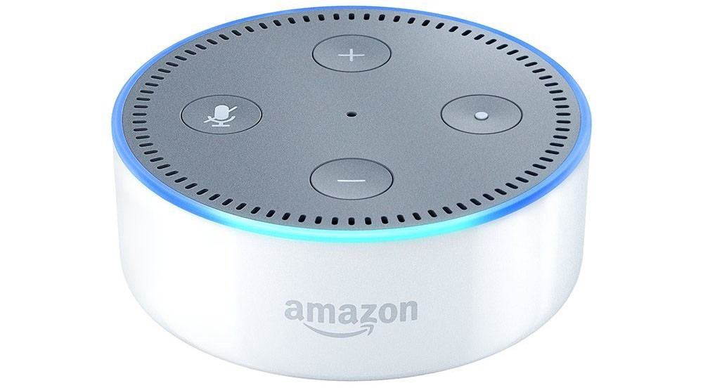
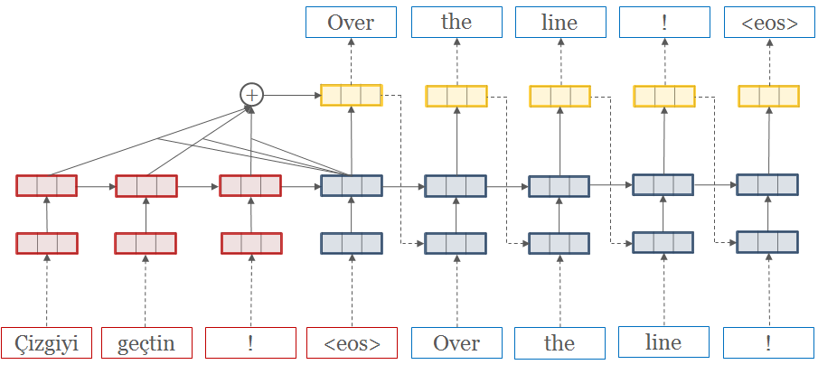
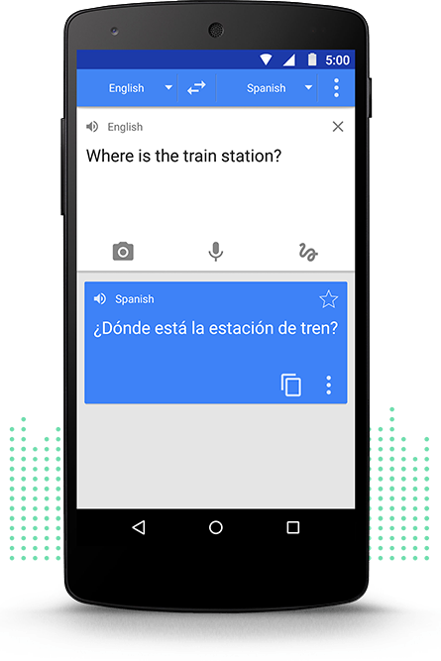
RNNs used to process temporal sequences
Speech Recognition
Machine Translation
Source: Adam Geitgey (Medium), opennmt.net, Google Translate

Slide 14
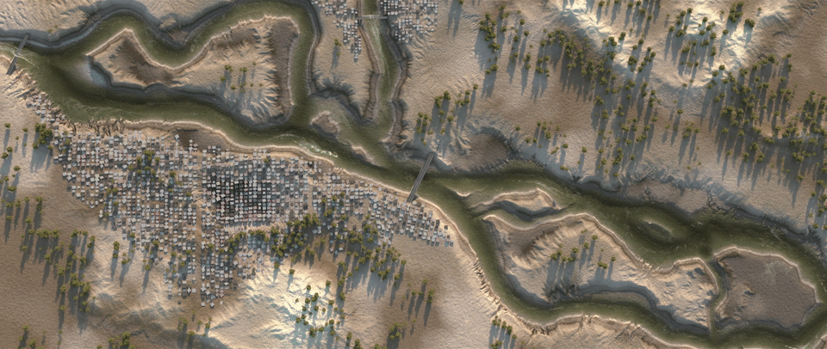
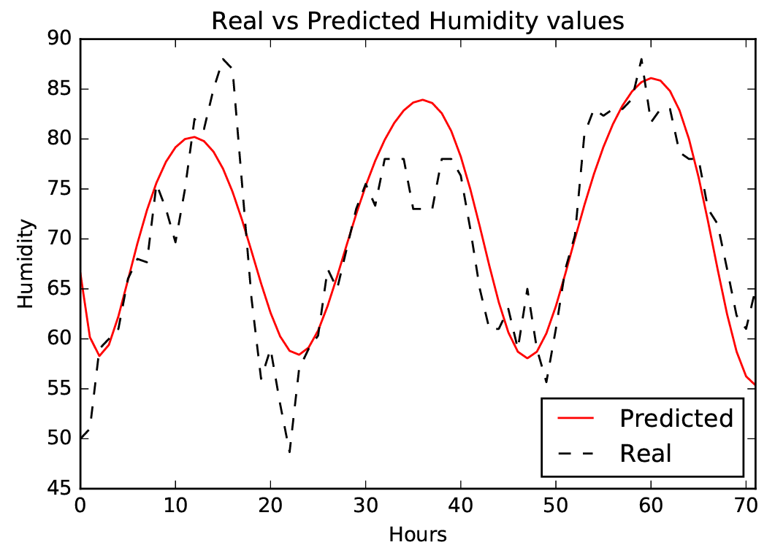
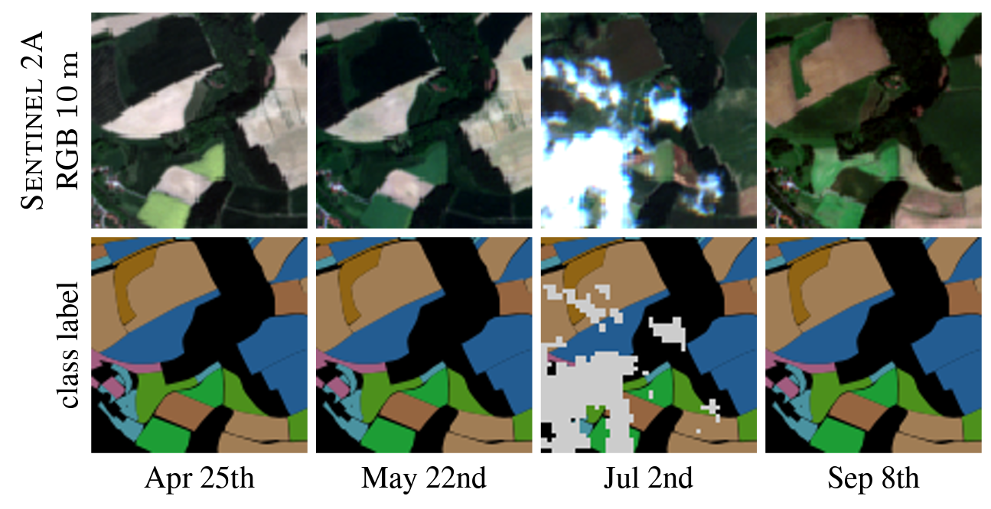
Catchment-independent rainfall-runoff models
Dynamic Time-Series Modeling
Dynamic Land Cover Classification
Source: Nadav Peleg (UNIL), Zaytar and El Amrani (2016), Russwurm et al. (2017)

Slide 15
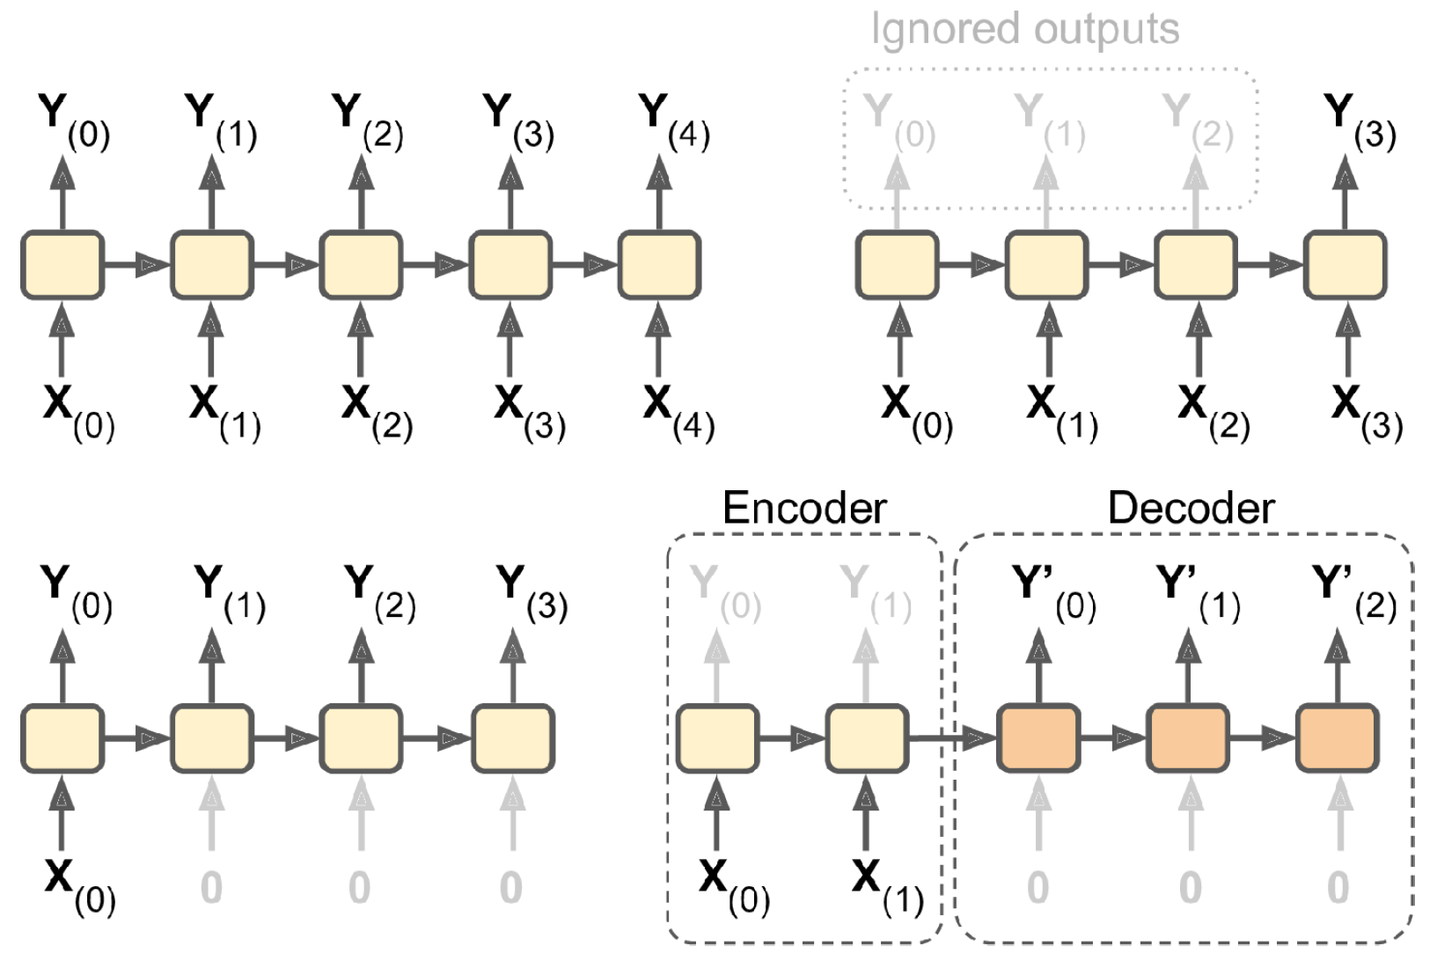
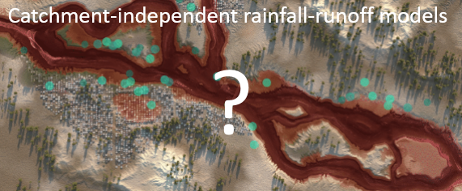
Forecasting Time-Series in Environmental Science
Seq-to-seq:
Env. Time Series Prediction
Seq-to-vector:
Make a single prediction
Encoder-dec:
Predicting time series of related but different vars
Vector-to-seq:
Predicting time series from 1 observ.

Slide 16
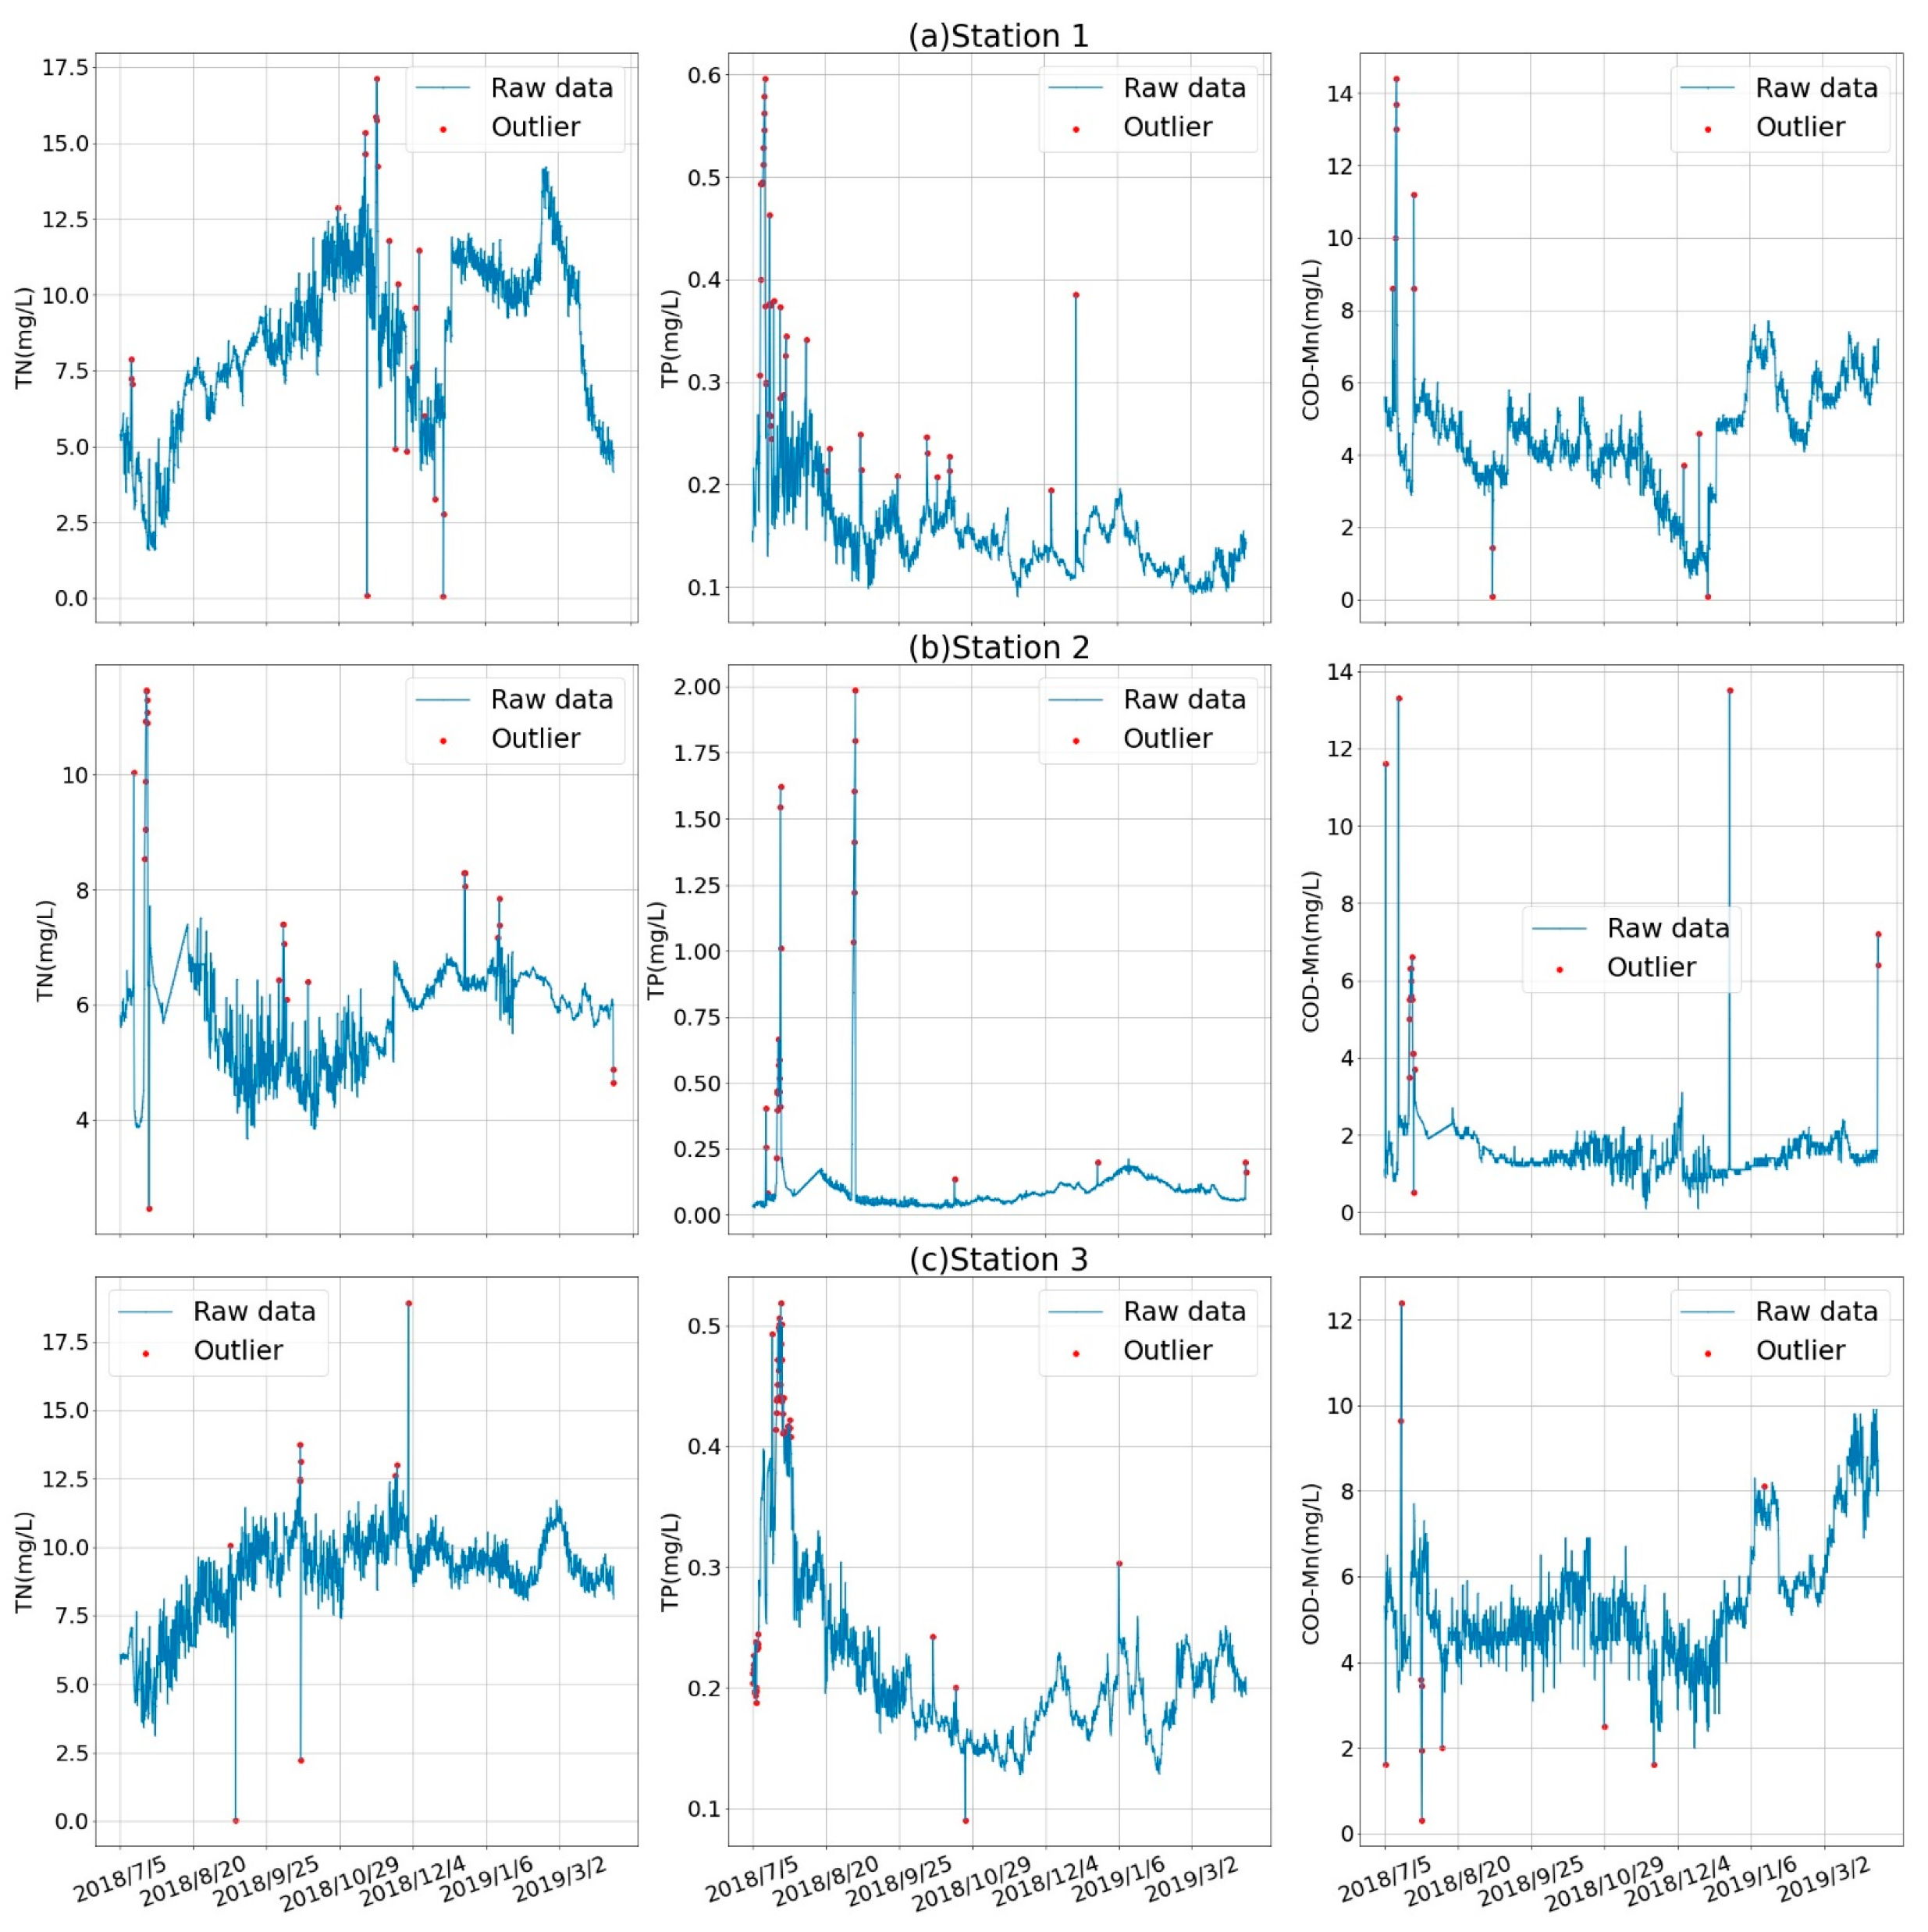
Why is naive forecasting (persistence forecast) so hard to outperform? Autocorrelation in time
Source: Zaytar and El Amrani (2016), Yan et al. (2021)
Notes:
Source : Water Quality Prediction in the Luan River Based on 1-DRCNN and BiGRU Hybrid Neural Network Model

Slide 17
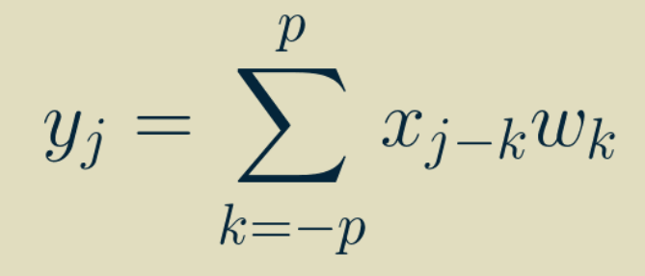
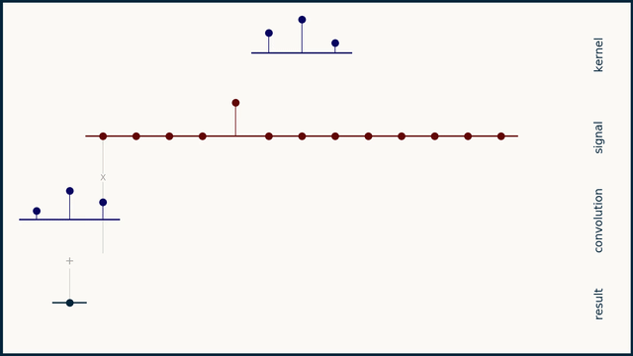
One-Dimensional Convolutional Neural Network (1D-CNN)
Output
Input
Weights
Simple & inexpensive
Source: Brandon Rohrer
Notes:
VOTE: How many weights in the first layer if we have to process two sequences of 10 steps? 20 steps?

Slide 18
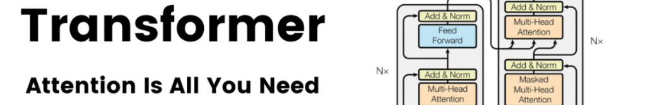
Min 30-35: Algorithms to process time series
Learning Objective 5 = Know at least three algorithms to process time-series
Vanilla RNN
LSTM
GRU
Transformers

Slide 19
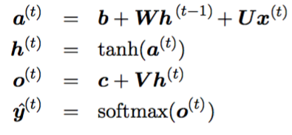
“Vanilla” Recurrent Neural Networks (RNNs)
Regularization Idea:
Use the same update rule (same weights W) to update the hidden state h(t) using inputs x(t) & h(t-1)
4
2
Source: Raimi Karim (Towards Data Science)
Notes:
Know at least three algorithms to process time-series
Unstable gradient problem = Decrease LR, use saturating activation fx, clip gradients, layer normalization, dropout
VOTE: How many weights in the first layer if we have to process two sequences of 10 steps? 20 steps?

Slide 20
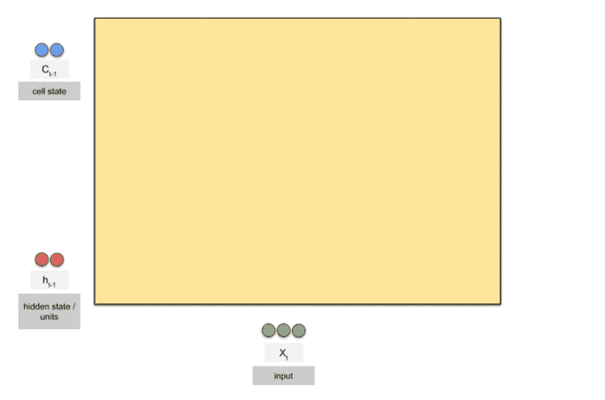
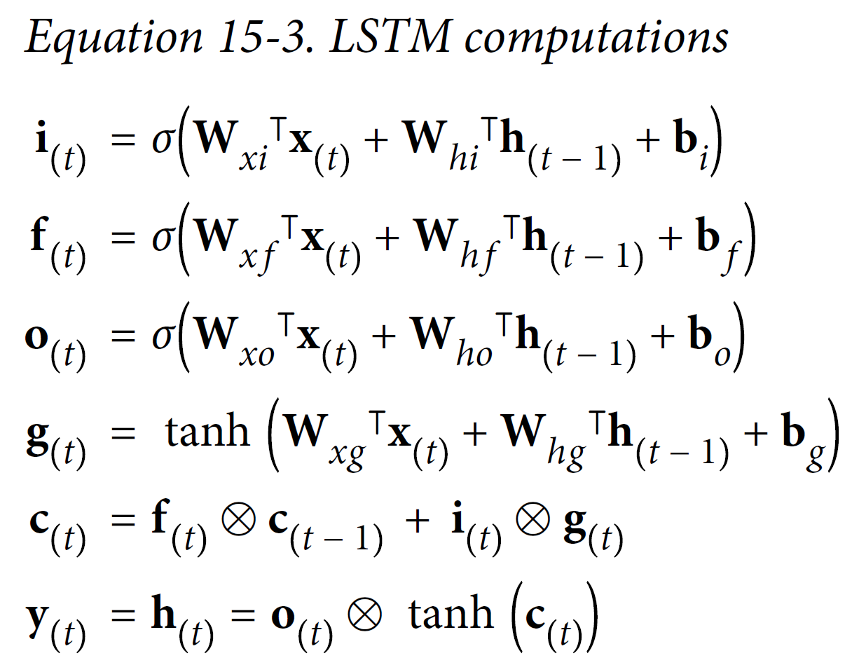
Long Short-Term Memories (LSTM)
Tackles the short-term memory problem by using long-term cell state c(t)
Source: Raimi Karim (Towards Data Science)
Notes:
Question: How the LSTM choose which information to keep, to remember and which information are not useful or irrelevant ? Question: How do LSTM cells recognise what informations must be passed on to the long-term state?

Slide 21
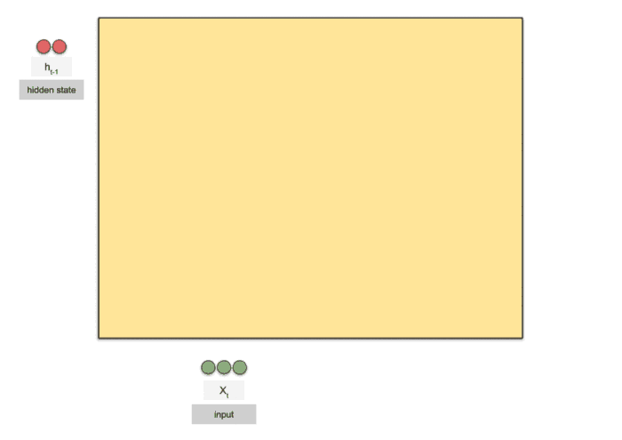
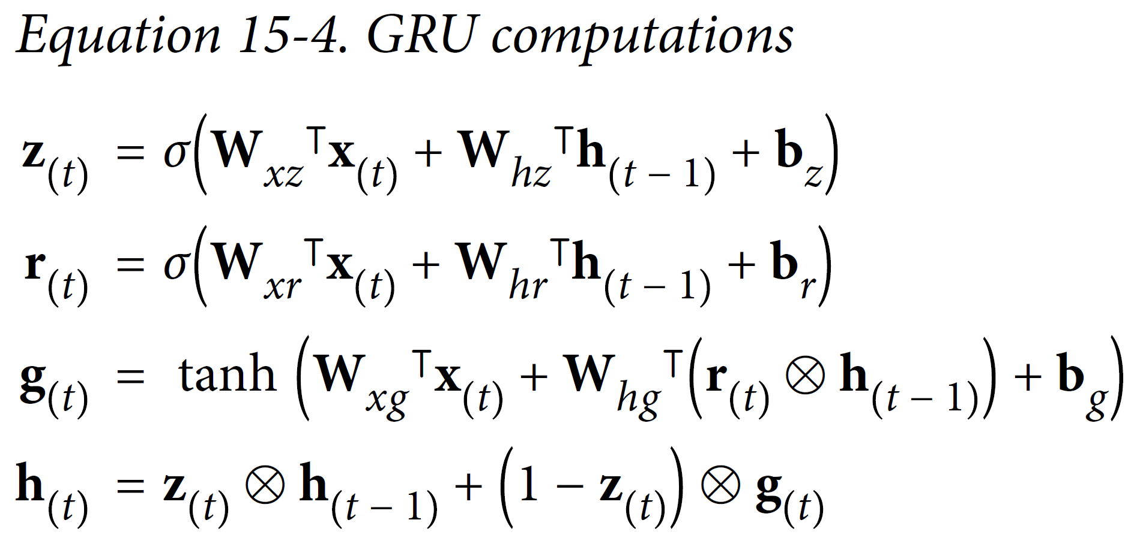
Gated Recurrent Units (GRU)
Simplifies the LSTM:
Single state vector h
Single gate controller z
No output gate, just r
Source: Raimi Karim (Towards Data Science)
Notes:
Question: How the LSTM choose which information to keep, to remember and which information are not useful or irrelevant ? Question: How do LSTM cells recognise what informations must be passed on to the long-term state?

Slide 22
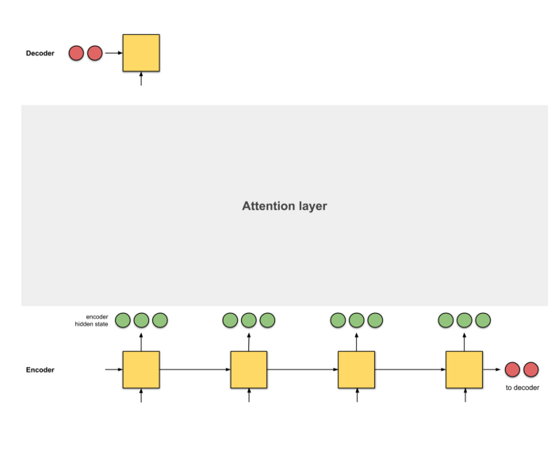
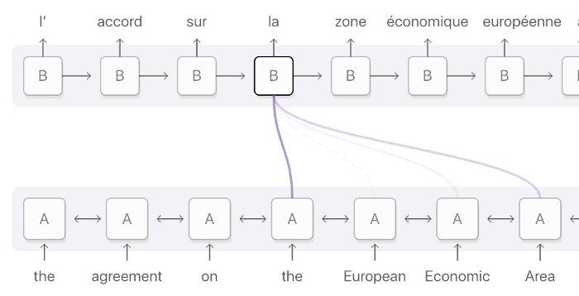
Attention = Interface between encoder & decoder to provide information about every hidden state
Attention layer = Alignment model
Source: Raimi Karim (Towards Data Science)
Notes:
VOTE: How many weights in the first layer if we have to process two sequences of 10 steps? 20 steps?

Slide 23

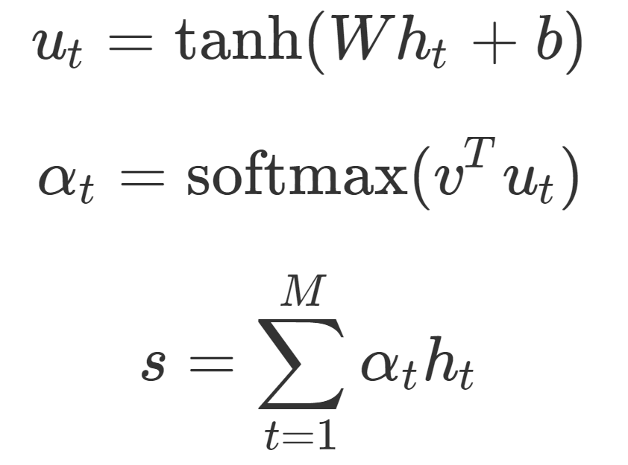
Step 0: Prepare hidden states
Source: Raimi Karim (Towards Data Science), Scott Rome

Slide 24
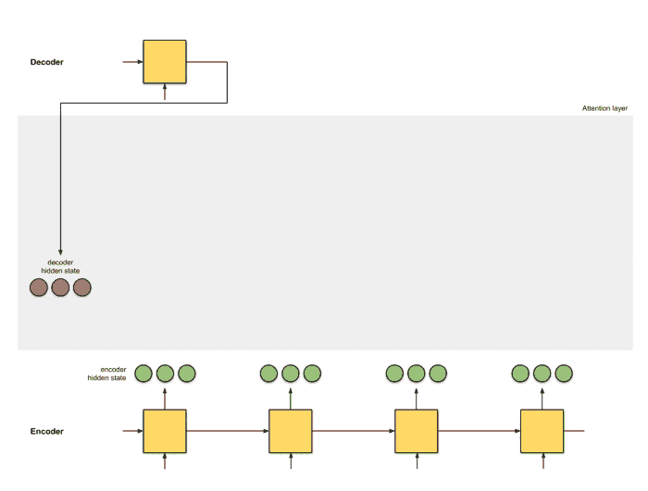
Step 1: Obtain score for every encoder hidden state
Source: Raimi Karim (Towards Data Science), Scott Rome
Notes:
Additive attention = tanh (Wh + W2 s) where s are past states
Multiplicative attention = h * W * s
Here, self attention

Slide 25
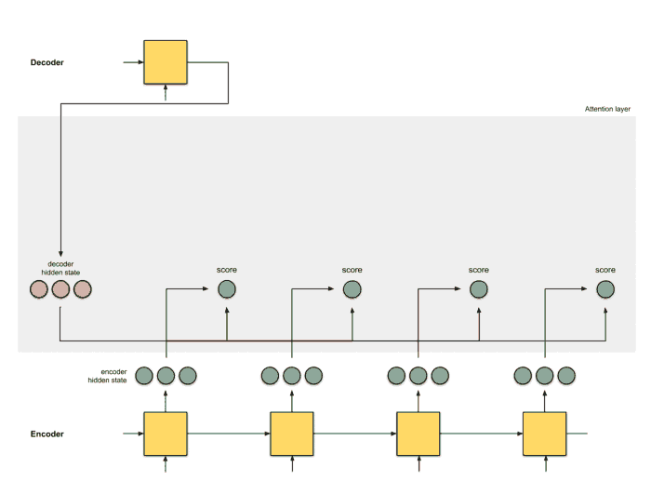
Step 2: Run all the scores through a softmax layer
Source: Raimi Karim (Towards Data Science), Scott Rome
Notes:
Question: How does the model know where to focus its attention ?

Slide 26

Step 3: (Encoder hidden states) x (Softmaxed score)
Source: Raimi Karim (Towards Data Science), Scott Rome

Slide 27
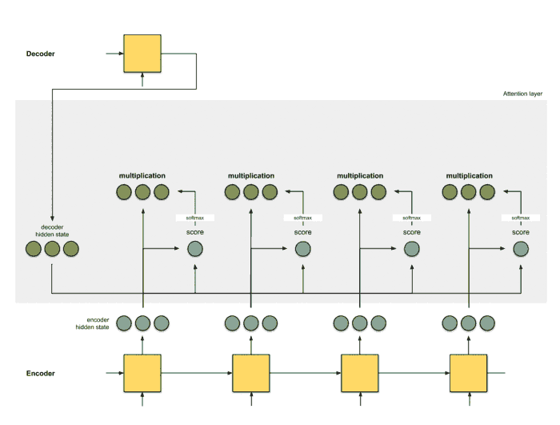
Step 4: Sum up the alignment vectors
Source: Raimi Karim (Towards Data Science), Scott Rome

Slide 28
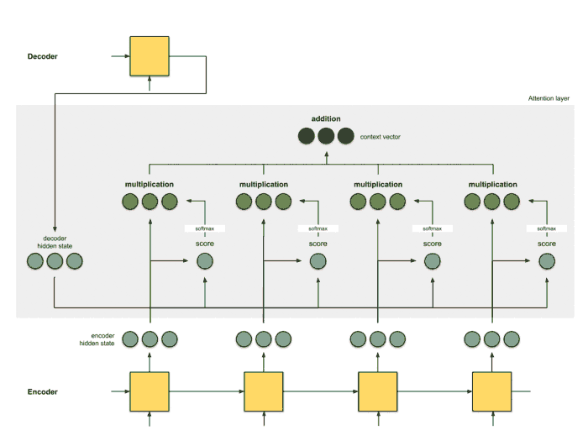
Step 5: Feed context vector into decoder
Source: Raimi Karim (Towards Data Science), Scott Rome

Slide 29
Attention = Interface between encoder & decoder to provide information about every hidden state
Attention layer = Alignment model
Source: Raimi Karim (Towards Data Science), Scott Rome

Slide 30
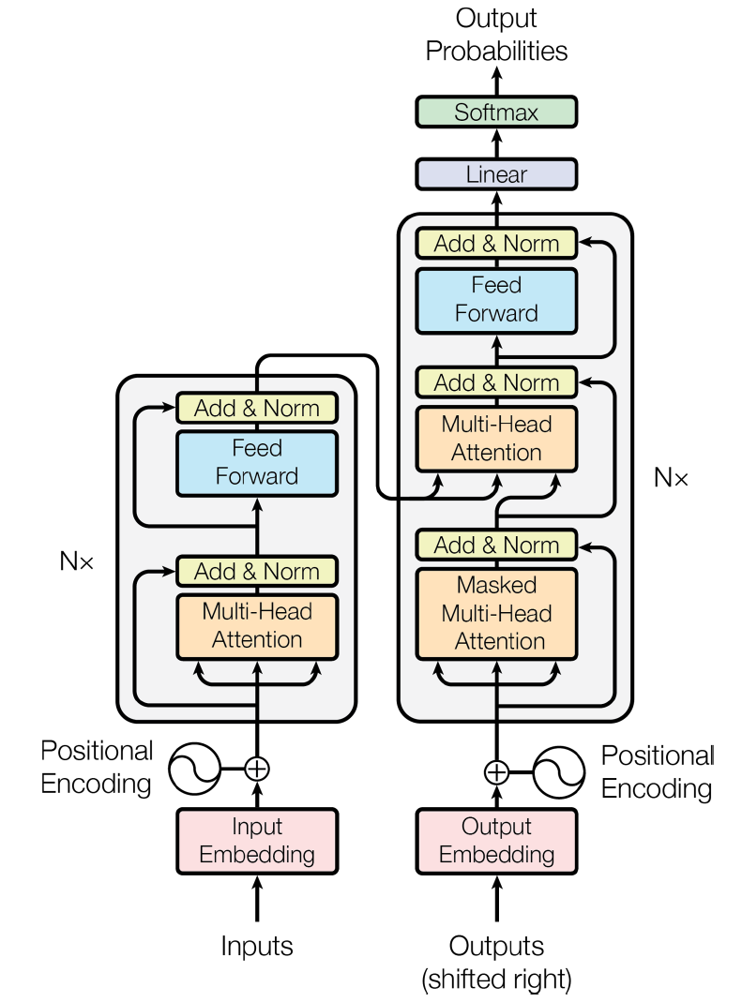
These attention (alignment) layers can be used to build the transformer architecture, revolutionizing NMT
Decoder
(stacked)
Encoder
(stacked)
Source: Géron, Fig 16-8
Notes:
The lefthand part is the encoder. Just like earlier, it takes as input a batch of sentences represented as sequences of word IDs (the input shape is [batch size, max input sentence length]), and it encodes each word into a 512-dimensional representation (so the encoder’s output shape is [batch size, max input sentence length, 512]). Note that the top part of the encoder is stacked N times (in the paper, N = 6).
The righthand part is the decoder. During training, it takes the target sentence as input (also represented as a sequence of word IDs), shifted one time step to the right (i.e., a start-of-sequence token is inserted at the beginning). It also receives the outputs of the encoder (i.e., the arrows coming from the left side). Note that the top part of the decoder is also stacked N times, and the encoder stack’s final outputs are fed to the decoder at each of these N levels. Just like earlier, the decoder outputs a probability for each possible next word, at each time step (its output shape is [batch size, max output sentence length, vocabulary length]).

Slide 31
Min 35-55: Graph Neural Networks for predictions on unstructured meshes
Learning Objectives (Labonne Ch. 1+2; Wu et al. 2019):
Define a graph
Identify applications where graph neural networks are effective
Describe at least three algorithms for making predictions on graphs

Slide 32
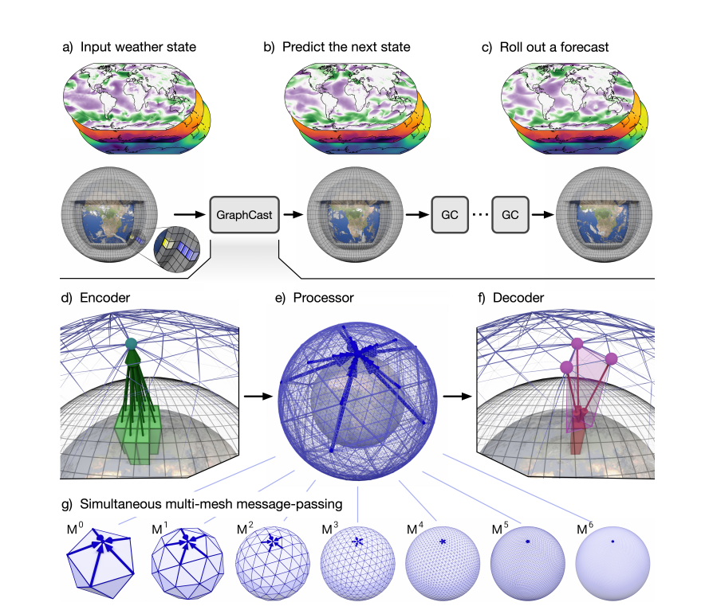
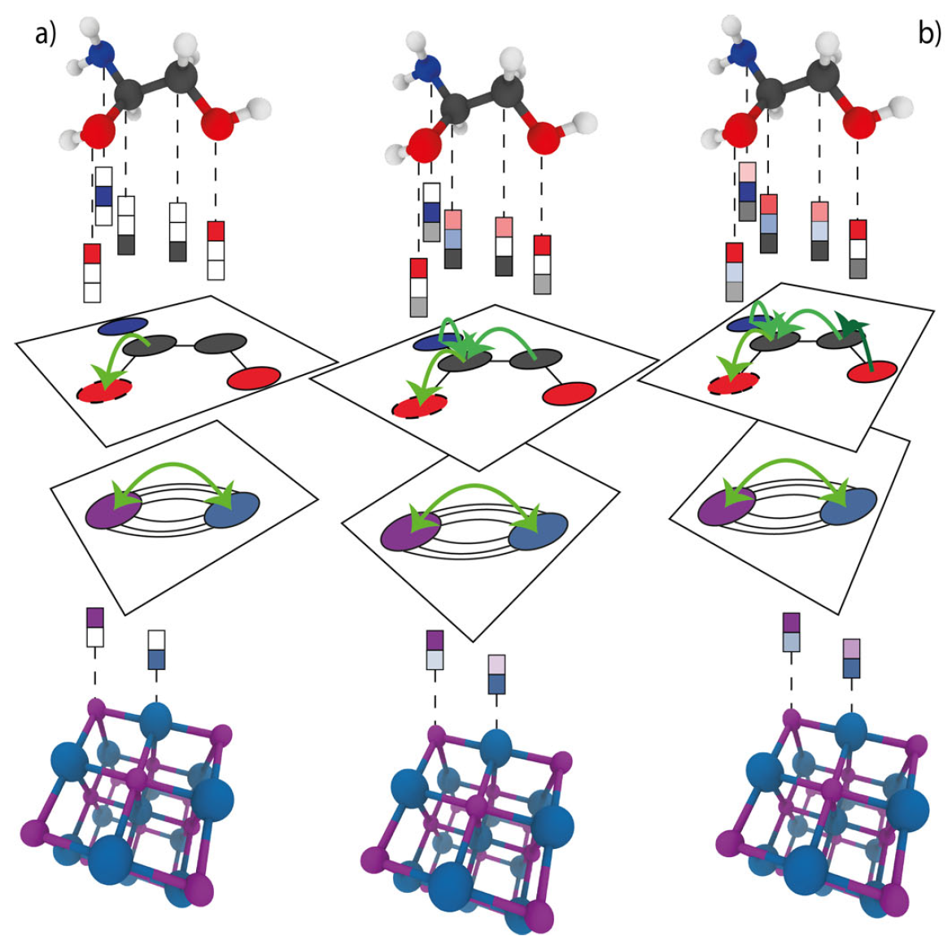
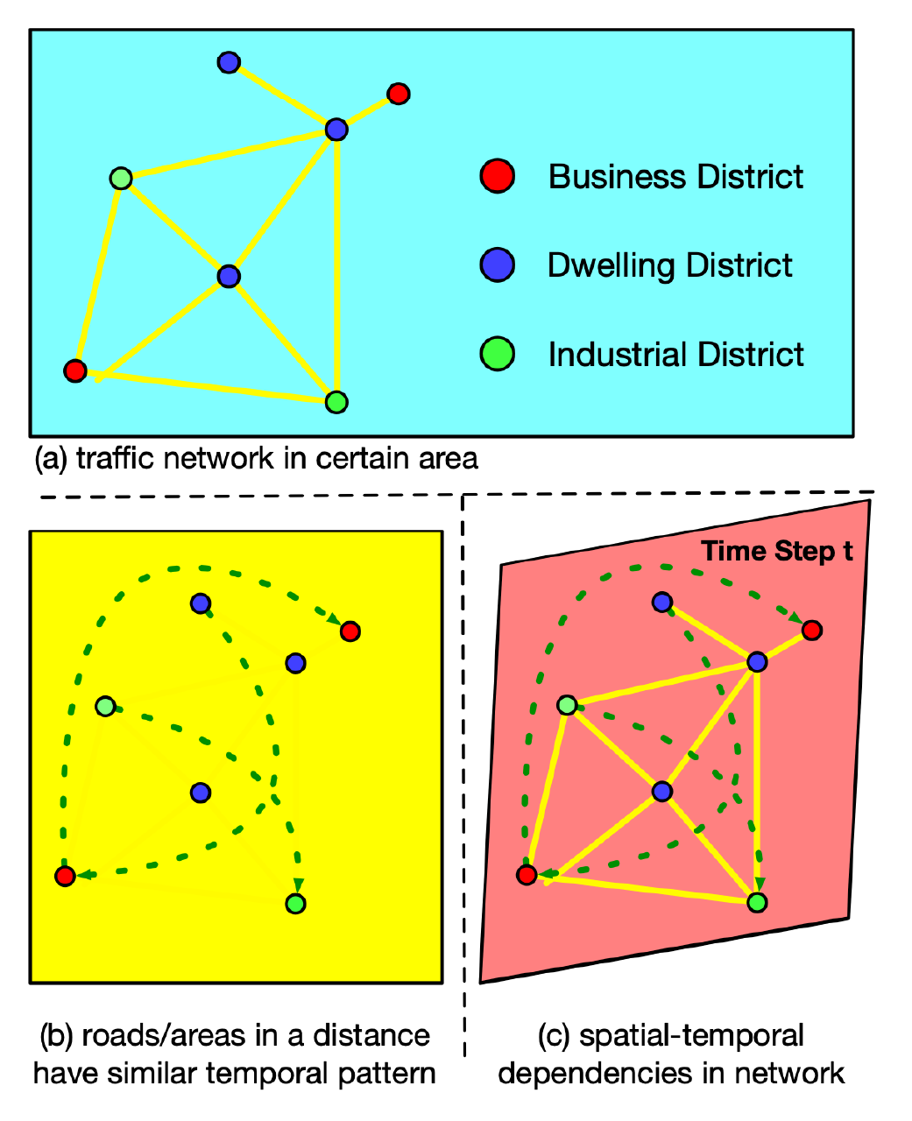
GNNs have led to breakthroughs in scientific ML Lam et al. (2023); Reiser et al. (2022); Li et al. (2021)

Slide 33
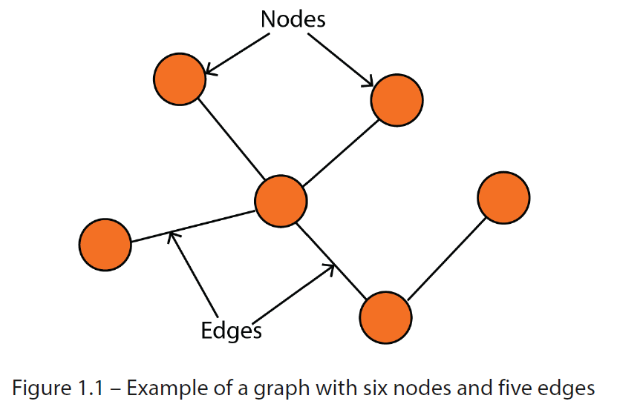
Graph = Nodes (Vertices) + Edges
Source: Labonne (Ch1)
Notes:
Graph = collection of nodes and edges

Slide 34
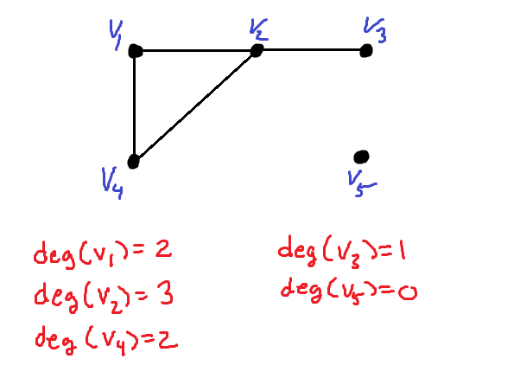
Graph = Nodes (Vertices) + Edges Degree of a node v = Number of edges incident to v
Source: Labonne (Ch1)
Notes:
Graph = collection of nodes and edges. Nodes represent entities and edges represent relationships.

Slide 35
Graph = Nodes (Vertices) + Edges Degree of a node v = Number of edges incident to v Adjacency matrix = 1 if nodes are connected, 0 otherwise
 | 1 | 2 | 3 | 4 | 5 | 6
1
2
3
4
5
6
1
2
3
6
4
5
Source: Labonne (Ch1)
Notes:
Graph = collection of nodes and edges. Nodes represent entities and edges represent relationships.

Slide 36
Graph = Nodes (Vertices) + Edges Degree of a node v = Number of edges incident to v Adjacency matrix = 1 if nodes are connected, 0 otherwise
 | 1 | 2 | 3 | 4 | 5 | 6
1 |  |  | 1
2 |  |  | 1
3 | 1 | 1 |  | 1 | 1
4 |  |  | 1
5 |  |  | 1 |  |  | 1
6 |  |  |  |  | 1
1
2
3
6
4
5
Source: Labonne (Ch1)
Notes:
Graph = collection of nodes and edges. Nodes represent entities and edges represent relationships.

Slide 37
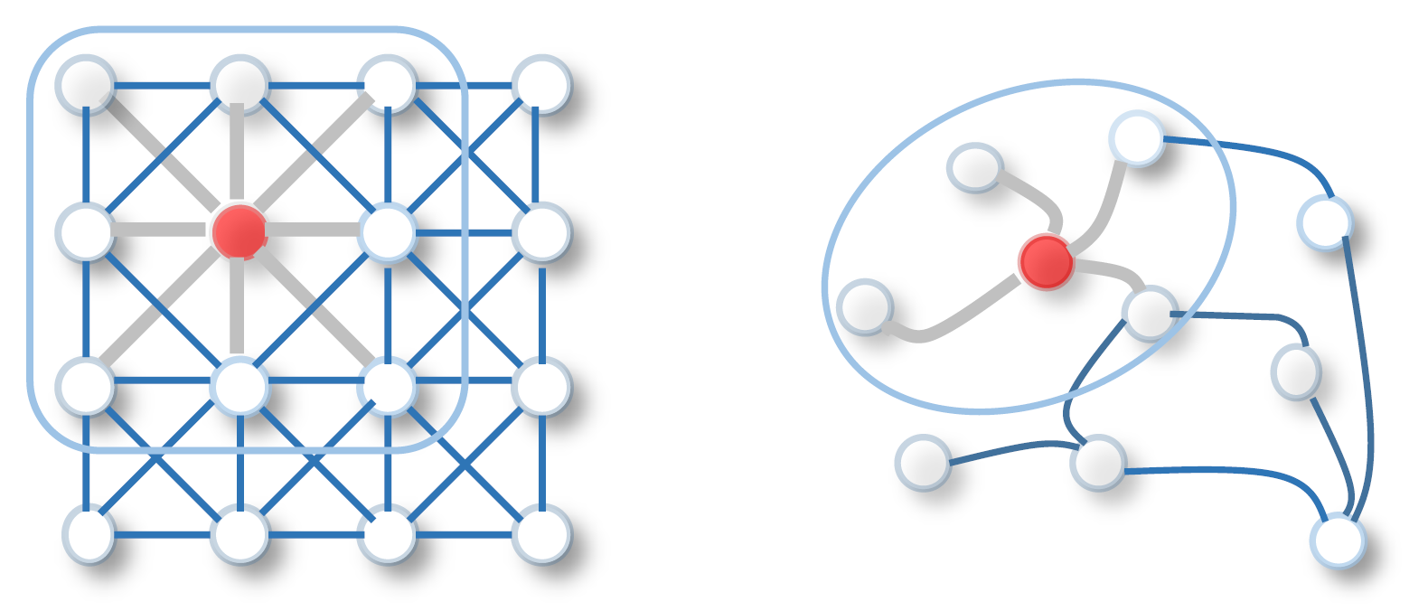
Graphs are well-suited for inter-connected systems & unstructured meshes
Source: Wu et al. (2019)

Slide 38
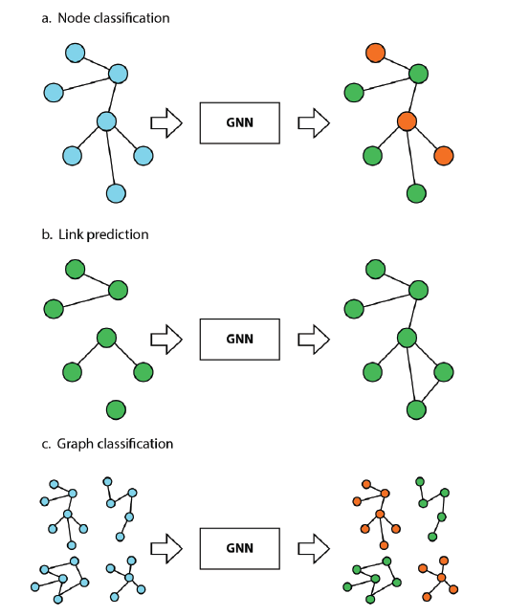
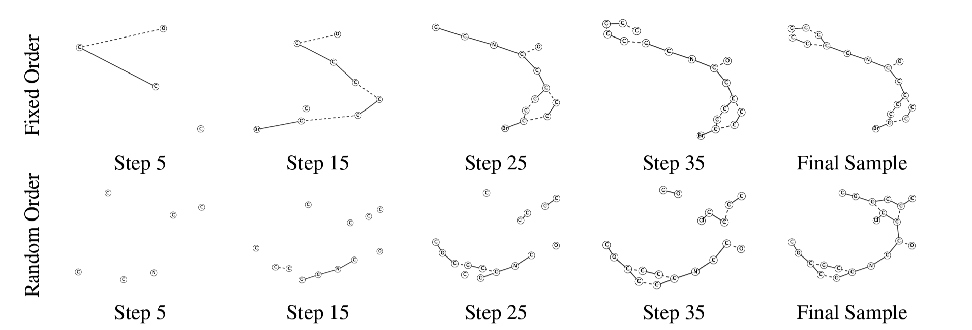
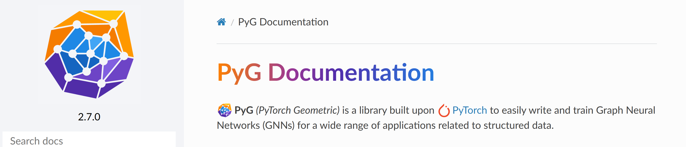
What kind of tasks can Graph NNs solve? Node & Edge-level prediction, graph classification & generation
PyTorch Geometric
Source: Labonne (2023); Li et al. (2018)
Notes:
+ Graph generation

Slide 39
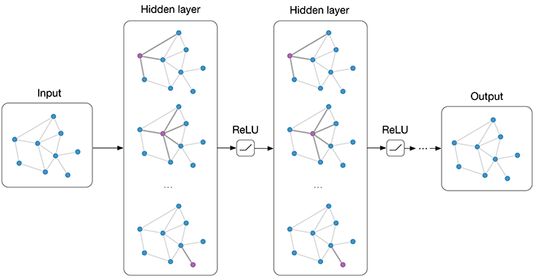
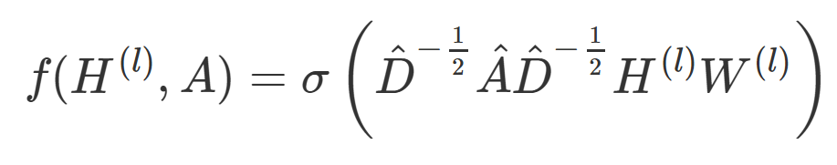
Node embedding = Learn suitable representation of node features Message passing = Information exchange between node and its neighbors
1) Graph Convolutional Networks (GCNs)
Normalization by degree
Source: Thomas Kipf (2016)
Implementation: Labonne Ch. 6

Slide 40


What if some neighboring nodes are much more important than others?
2) Graph Attention Networks (GATs)
Normalized attention weights:
Source: Velickovi et al. (2018) Implementation: Labonne Ch. 7

Slide 41


What if the graph structure is not known ahead of time?
3) GraphSAGE samples a fixed-size neighborhood and aggregates their information
Source: Khemani et al. (2018) Implementation: Labonne Ch. 8

Slide 42



Min 105-120: Break

Slide 43
Legacy slides

Slide 44


Introduction to Natural Language Processing (NLP) = Programming CPUs to Analyze Natural Language Data
Chopping the dataset into multiple windows to predict sequence shifts
Stateful RNN: Remembering the previous sequence to predict the next
Requires non-overlapping sequence
Chopping the dataset into multiple windows to predict sequence shifts
Notes:
NLP is a subfield of linguistics, computer science, and artificial intelligence concerned with the interactions between computers and human language, in particular how to program computers to process and analyze large amounts of natural language data. (Wikipedia)
Batching is harder, but it is not impossible. For example, we could chop Shakespeare’s
text into 32 texts of equal length, create one dataset of consecutive input sequences
for each of them, and finally use tf.data.Dataset.zip(datasets).map(lambda
*windows: tf.stack(windows)) to create proper consecutive batches, where the nth
input sequence in a batch starts off exactly where the nth input sequence ended in the
previous batch (see the notebook for the full code).

Slide 45


Encoding Categorical Features using Embeddings
Simpler alternative to one-hot encoding with user-chosen (# of dimensions)
Will gradually improve during training
Source: Géron (Ch13)

Slide 46


Machine Translation Models
Training the model
Using the model (inference time)
Source: Géron (Ch16)
Notes:
At each step, the decoder outputs a score for each word in the output vocabulary (i.e., French), and then the softmax layer turns these scores into probabilities. For example,
at the first step the word “Je” may have a probability of 20%, “Tu” may have a probability of 1%, and so on. The word with the highest probability is output. This is
very much like a regular classification task, so you can train the model using the "sparse_categorical_crossentropy" loss, much like we did in the Char-RNN model.
Note that at inference time (after training), you will not have the target sentence to feed to the decoder. Instead, simply feed the decoder the word that it output at the
previous step, as shown in Figure 16-4 (this will require an embedding lookup that is not shown in the diagram).

